Slide 1

FIN 545 · LINKEDIN INVESTMENT PITCH
OUR VERDICT
Campus Brew Café
Invest with Conditions
Should we invest ₹29.30 lakh in a 30-seat café near LPU, Phagwara?
₹2.03 lakh
NPV at 13.3% WACC
15.3%
By Harleen Kaur
M.Com · Reg. No. 123514334
Lovely Professional University · Mittal School of Business
Faculty: Dr Basit
Project IRR
4.1 years
Payback
Notes:
Hi, I am Harleen Kaur, an M.Com student at Lovely Professional University. This is my investment pitch for Campus Brew Café, a 30-seat café near LPU.

Slide 2



The problem, the customer and the solution
A large, concentrated campus market that is short of affordable places to sit, eat and meet
Problem
Customer
Solution
At peak hours, seating near the LPU gate is limited. Students want an affordable, comfortable place to eat, meet and study between classes.
LPU students, faculty and staff (30,000+ students on one campus), plus travellers on the GT Road (NH-44) corridor.
A 750 sq ft, 30-seat café with beverages, snacks and meal combos at student prices: average bill ₹160 before GST, run by five staff.
Business model in one sentence: the project invests about ₹29.3 lakh to provide food and beverages to students and staff in the LPU catchment, earning revenue through per-customer bills.
Unit of economics: one paid customer visit.
Source: 01_Project_Definition; SRC-07 (Careers360, LPU profile)
Harleen Kaur · FIN 545 · LPU
Notes:
LPU has more than 30,000 students on a single campus, and at peak hours there are not enough affordable places near the gate to sit, eat and meet. Our solution is Campus Brew Café: a 30-seat café serving beverages, snacks and meal combos at an average bill of 160 rupees, for students, staff and GT Road travellers. Our unit of economics is one paid customer visit.

Slide 3
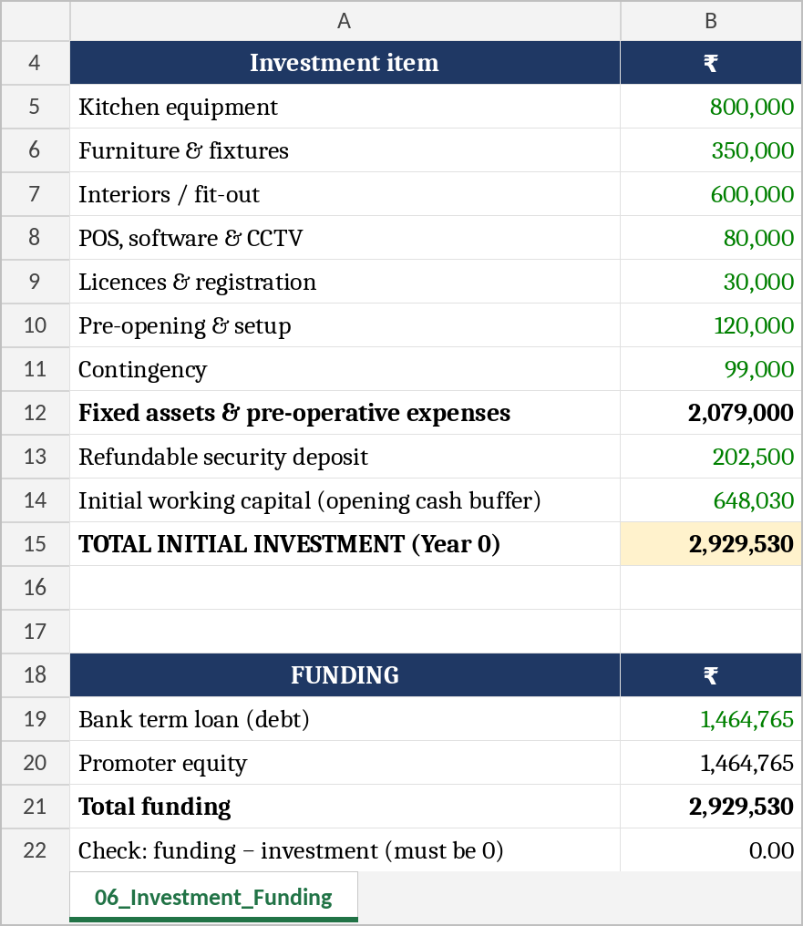
Initial investment and funding
₹29.30 lakh committed at Year 0, funded 50% bank debt and 50% promoter equity
Where the money goes (₹ lakh)
₹14.65 lakh
Bank term loan: 10% interest, 5 years, equal annual repayments
₹14.65 lakh
Promoter equity: the owner commitment a lender expects
Leased premises, no subsidy assumed, and the cash buffer equals two months of Year-1 operating cost.
Total ₹29.30 lakh
Excel snippet: 06_Investment_Funding (₹). Funding check = 0
Harleen Kaur · FIN 545 · LPU
Notes:
The project needs 29.30 lakh rupees at Year 0: 20.79 lakh for equipment, furniture, fit-out and set-up; a 2.03 lakh refundable rent deposit; and a 6.48 lakh opening cash buffer. It is funded 50:50, with a 14.65 lakh bank term loan at 10% over five years and 14.65 lakh of promoter equity. Funding equals investment exactly.

Slide 4
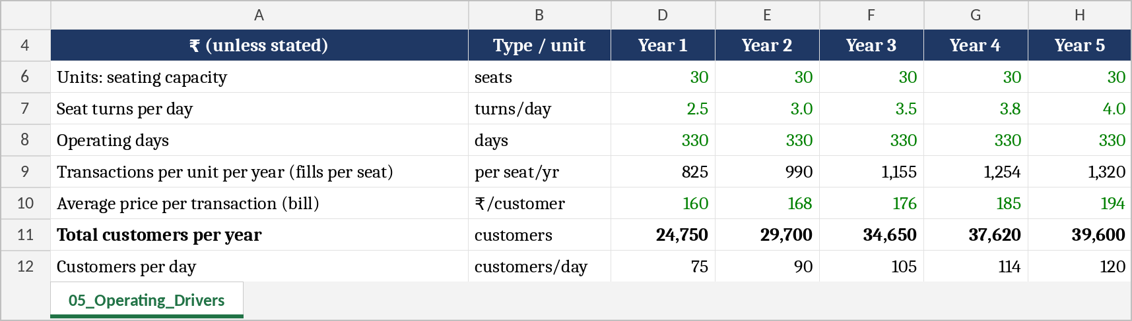
Operating drivers, revenue and cost model
Revenue is built from physical capacity, not typed in
30
×
2.5 → 4.0
×
330
×
₹160
=
₹39.6 lakh
seats
seat turns per day
days open
average bill, +5% a year
Year-1 revenue
Cost model
Variable: 36% of sales
Ingredients 32% + packaging 4%
Fixed: ₹24.63 lakh in Year 1
Salaries ₹11.73L, rent ₹8.10L, overheads
Semi-variable: electricity
60% fixed, 40% moves with customers
75 customers a day in Year 1 rising to 120 by Year 5: a small share of a 30,000+ campus.
Excel snippet: 05_Operating_Drivers. Costs: 08_Cost_Model
Harleen Kaur · FIN 545 · LPU
Notes:
Revenue is built from capacity, not guessed. 30 seats, turned 2.5 times a day in Year 1 rising to 4, over 330 days, at an average bill of 160 rupees that grows 5% a year. That gives 39.6 lakh of revenue in Year 1 and about 77 lakh in Year 5. On costs, food and packaging are variable at 36% of sales, while salaries, rent and overheads are fixed at about 24.6 lakh in Year 1.

Slide 5
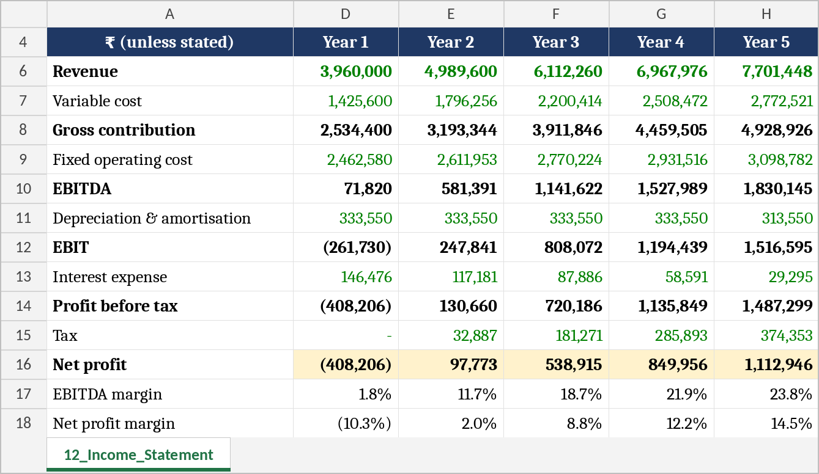
Financial performance: Years 1 to 5
A thin first year, then strong operating leverage as customers grow
EBITDA margin climbs from 1.8% to 23.8%; net profit reaches ₹11.13 lakh in Year 5.
Excel snippet: 12_Income_Statement (₹). Balance sheet balances in every year (14_Balance_Sheet)
Harleen Kaur · FIN 545 · LPU
Notes:
Year 1 is roughly break-even at EBITDA level, with a small net loss once interest and depreciation are charged. As customers grow while fixed costs rise slowly, EBITDA margin climbs from 1.8% to 23.8%, and net profit reaches 11.1 lakh by Year 5.

Slide 6
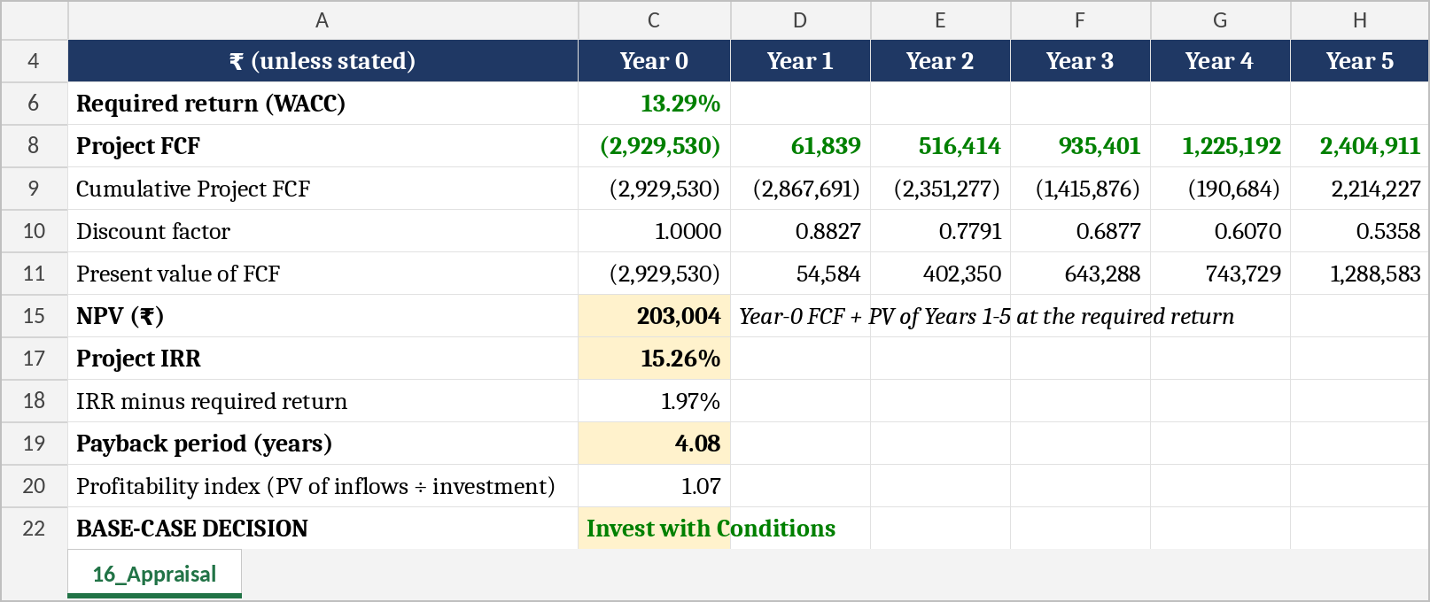
NPV, IRR and payback
Project free cash flow, discounted at a 13.29% WACC, clears the hurdle but narrowly
₹2.03 lakh
15.3%
4.1 years
1.07
NPV: value created
IRR vs 13.3% required return
Payback within a 5-year horizon
Profitability index
Excel snippet: 16_Appraisal. NPV checked two ways (NPV function and sum of PVs)
Harleen Kaur · FIN 545 · LPU
Notes:
On project free cash flow, which excludes financing, and discounted at a WACC of 13.3%, the NPV is plus 2.03 lakh, the IRR is 15.3%, and payback is 4.1 years. So the café clears the hurdle, but only narrowly.

Slide 7
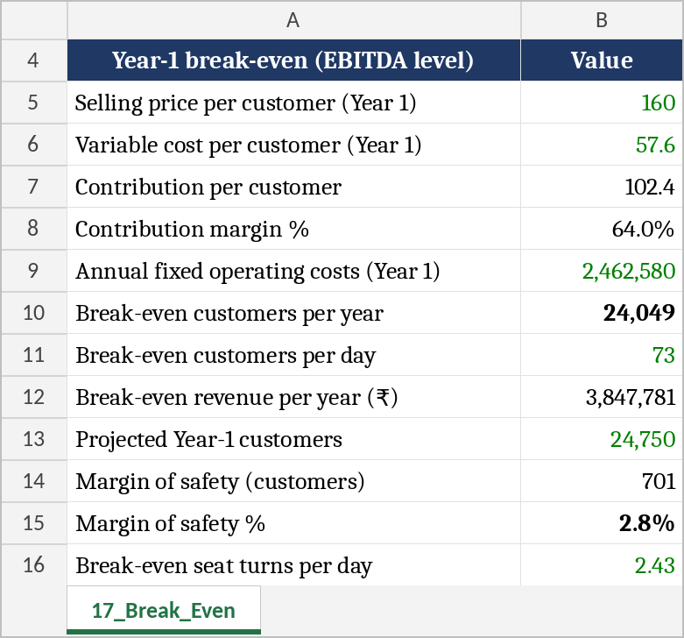
Break-even and margin of safety
Year 1 needs 73 customers a day; the plan assumes 75
2.8%
18.2%
37.1%
Margin of safety, Year 1
Year 2
Year 5
Excel snippet: 17_Break_Even (EBITDA level)
Harleen Kaur · FIN 545 · LPU
Notes:
Break-even is tight at the start. In Year 1 we need 73 customers a day to cover fixed costs and we plan for 75, a margin of safety of only 2.8 percent. It widens quickly, to 18 percent in Year 2 and 37 percent by Year 5.

Slide 8
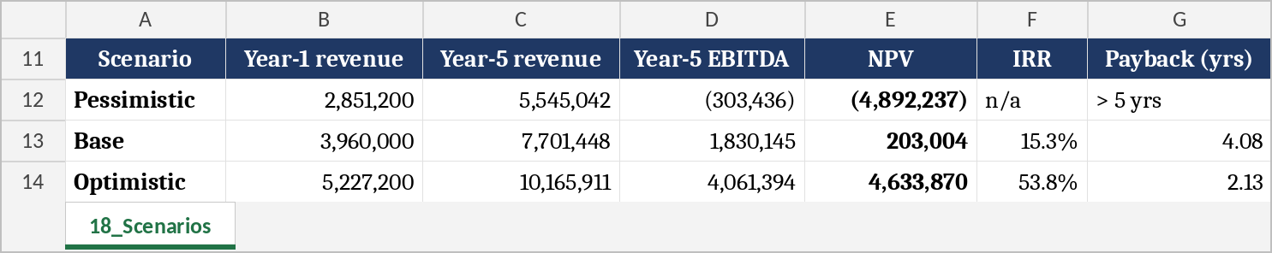
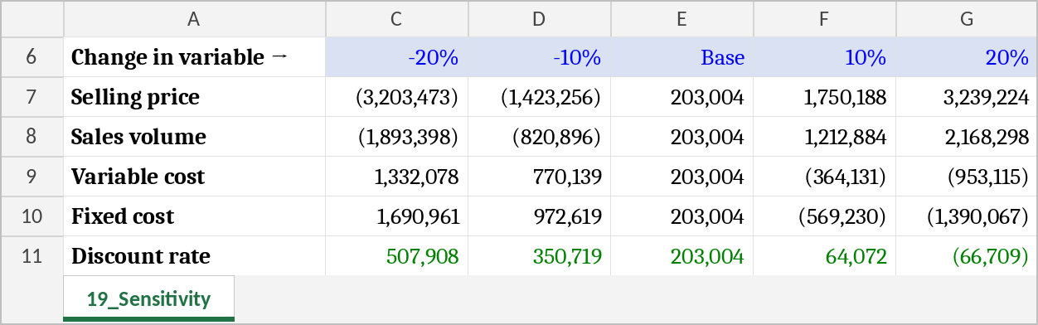
Scenarios, sensitivity and the biggest risk
The downside is much deeper than the base-case gain
Scenario analysis
Sensitivity of NPV (₹), one variable at a time
Biggest risk: selling price
An average bill just 1.2% below plan, or 2.0% fewer customers, turns the NPV negative.
Excel snippets: 18_Scenarios and 19_Sensitivity (₹)
Harleen Kaur · FIN 545 · LPU
Notes:
The risk is asymmetric. In the pessimistic case, with volume down 20 percent, price down 10 percent and costs up 10 percent, the NPV falls to minus 48.9 lakh. Sensitivity shows the biggest risk is selling price: an average bill just 1.2 percent below plan wipes out the NPV, followed by customer volume.

Slide 9
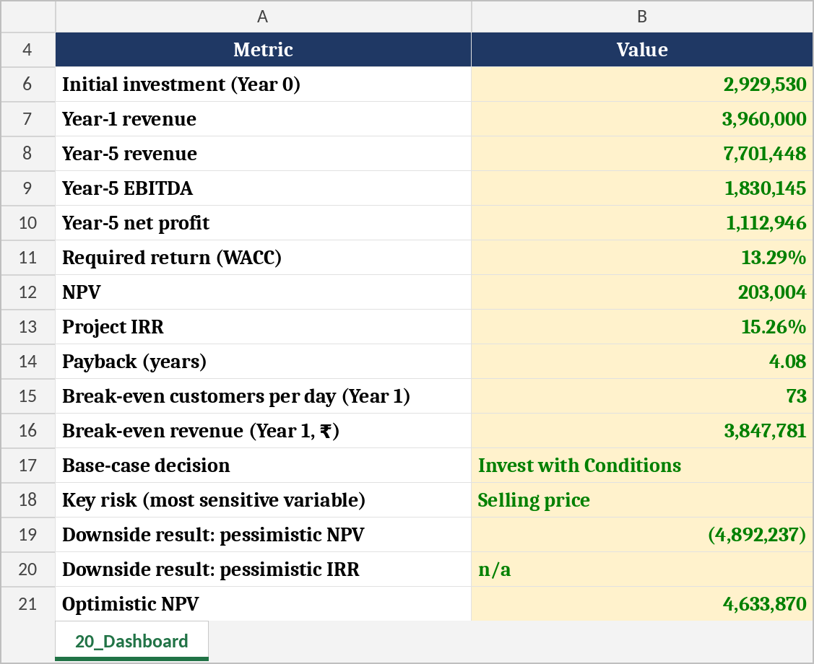
Investment recommendation
Every number below is a live link in the investment committee dashboard
DECISION
Invest with Conditions
Why not a plain "Invest"
Why not "Do Not Invest"
Thin cushion: PI 1.07, IRR only 2 points above WACC
Pessimistic NPV is (₹48.92 lakh)
Rent, capex, bill and footfall are estimates, not quotes
NPV and IRR both clear the hurdle
Café stays cash positive; loan repaid by Year 5
Margins scale strongly; optimistic NPV ₹46.34 lakh
Excel snippet: 20_Dashboard (₹). Decision rule in 16_Appraisal
Harleen Kaur · FIN 545 · LPU
Notes:
So our recommendation is Invest with Conditions. The base case creates value and the café stays solvent, but the cushion is thin and the downside is deep, so we do not recommend an unconditional yes.

Slide 10
Conditions before we commit the money
Turn the biggest uncertainties into checks we pass before, and soon after, opening
1
Firm up rent and capex
2
Confirm the average bill
3
Validate demand first
Rent at or below ₹90/sq ft; equipment, furniture, fit-out and POS within ₹18.3 lakh.
Local competitor menus support at least ₹160 before GST.
Footfall evidence of 75+ customers a day before full fit-out.
4
Control early costs
5
Monitor after opening
6
Pursue upside levers
Hold staff at five; negotiate a rent-free fit-out period or capped escalation.
Formal review if customers stay below 73 a day for three months in a row.
Seek MSME or start-up support; test a higher-margin menu mix.
Derived from 16_Appraisal, 17_Break_Even and 19_Sensitivity
Harleen Kaur · FIN 545 · LPU
Notes:
We proceed only after firm quotes for rent and capex, a confirmed 160 rupee average bill, and footfall evidence above 75 customers a day, with monthly monitoring after opening. Thank you for watching.

Slide 11
Thank you
Campus Brew Café · Invest with Conditions · NPV ₹2.03 lakh · IRR 15.3% · Payback 4.1 years
Harleen Kaur · M.Com · Reg. No. 123514334
#LovelyProfessionalUniversity #MSOB #QD06FINANCE #DrBasit
FIN 545 Workshop on Financial Modelling · Full model and report available on request
Notes:
Closing frame: hold for 2 to 3 seconds. Paste the same hashtags in the LinkedIn post caption: #LovelyProfessionalUniversity #MSOB #QD06FINANCE #DrBasit. Then submit the LinkedIn post URL.

